Slide 1

Team Netsky

Slide 2
Table of contents
1. Our Team
2. Stages of realization
3. Used technologies

Slide 3

01
Our Team
Everything you need to know about us (:

Slide 4
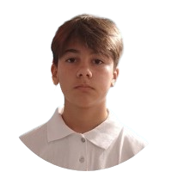
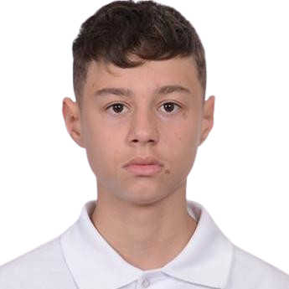
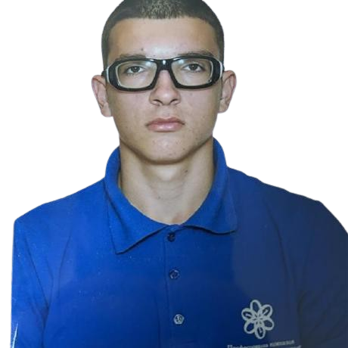
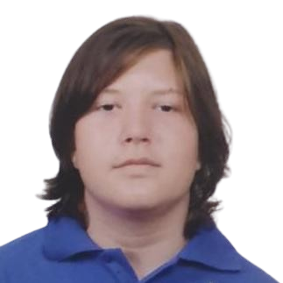
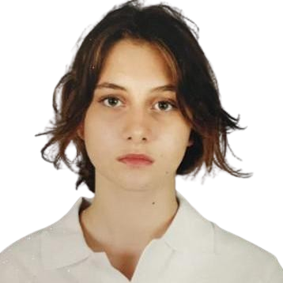
Team Netsky
Petar Dimitrov
Velizar Vulkov
Kaloyan
Pozharliev
Back-end Dev.
Scrum-trainer
Georgi
Pavlov
Ivayla
Keserdzhieva
Co-Designer
Designer
Back-end Dev.

Slide 5
02
Stages of realization
How we came up with the idea (:

Slide 6
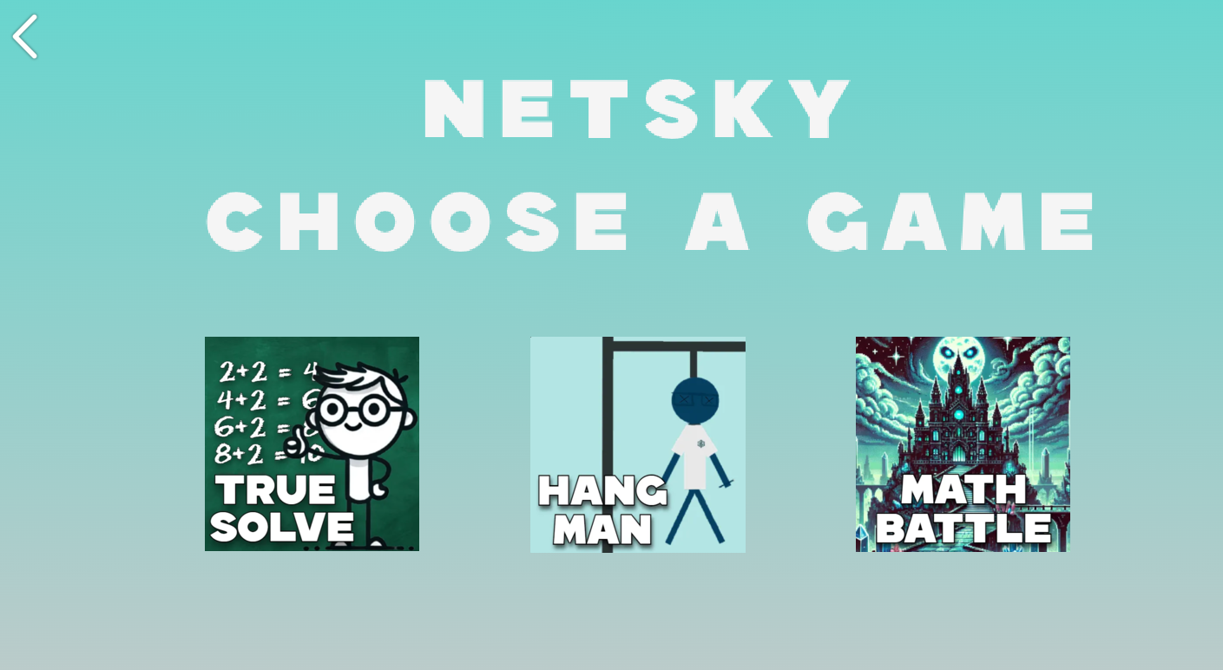
Stages of realization
Our idea was to create a game where you have a variety of easy to pick up lesson based games that are engaging and beneficial for you

Slide 7
03
Used technologies
The technologies used in the project(:

Slide 8










The tools and technologies used

Slide 9
04
Lets go to our project
https://github.com/codingburgas/sprint-math-games-9th-grade-netsky.git (:

